Slide 1

Bell Work: Simplify
$$1.) sin⁡t csc⁡t – cos⁡t sec⁡t$$
$$2.) csc⁡x sec⁡x – tan⁡x$$
$$3.) \frac{1−\sin^{2}x}{\csc^{2}x−1}$$

Slide 2
From Last Time
Page 297 #5, 9-19 (odd), 27, 34, 49-53 (odd), 59
Get a Head Start…
Page 306 #1, 5-6, 30-31, 37-40, 45, 47, 57, 63-64, 67, 71

Slide 3
Pre-calc trig
Day 34

Slide 4
4.3 Right Triangle Trigonometry
Objective: Evaluate trig functions of acute angles and use fundamental trig identities while solving real-life problems

Slide 5
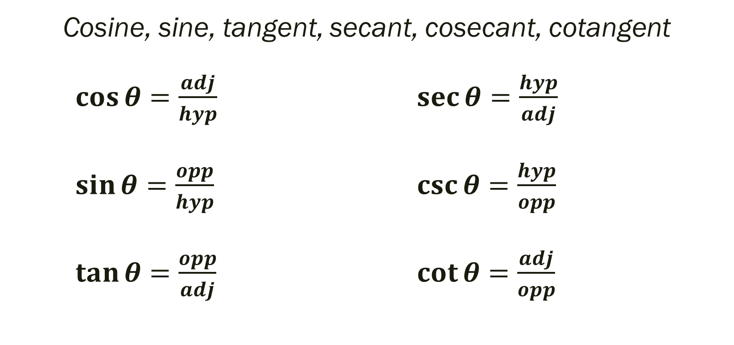
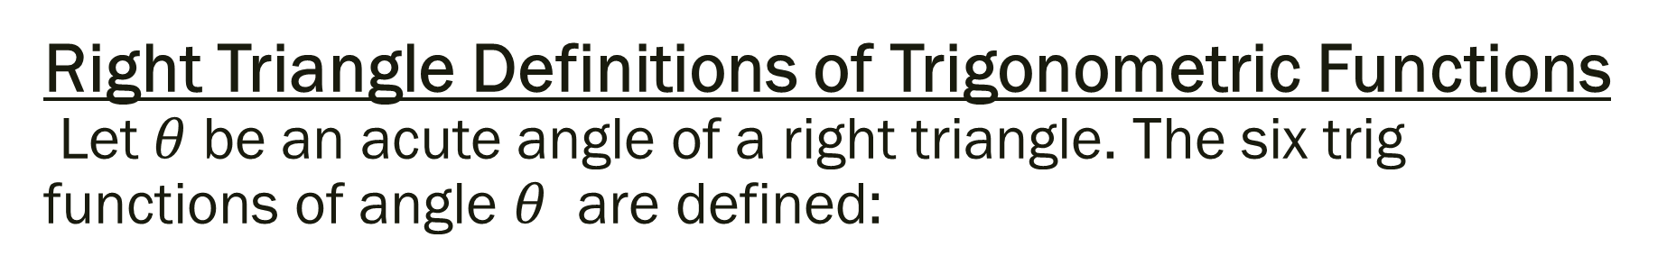
Right Triangle Definitions of Trigonometric Functions Let $θ$ be an acute angle of a right triangle. The six trig functions of angle $θ$ are defined:
Cosine, sine, tangent, secant, cosecant, cotangent
$\cos{θ=\frac{adj}{hyp}}$ $\sec{θ=\frac{hyp}{adj}}$
$\sin{θ=\frac{opp}{hyp}}$ $\csc{θ=\frac{hyp}{opp}}$
$\tan{θ=\frac{opp}{adj}}$ $\cot{θ=\frac{adj}{opp}}$

Slide 6
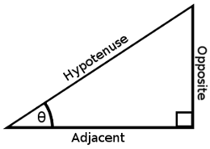
----SOH----CAH----TOA----
The abbreviations in the previous slide: opp, adj, hyp
represent the lengths of the sides of the right triangle
(as seen in the picture)
opp = length of side opposite given θ
adj = length of side adjacent to given θ
hyp = length for of hypotenuse

Slide 7

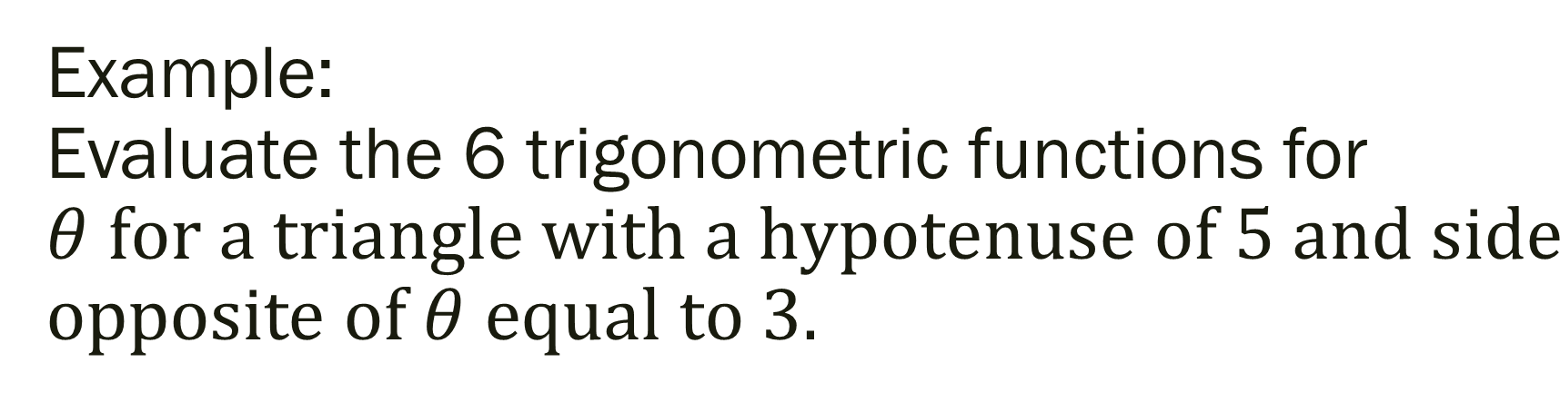
Example: Evaluate the 6 trigonometric functions for $θ for a triangle with a hypotenuse of 5 and side$ opposite of $θ equal to 3.$
$\cos{θ=}$ $\sec{θ}=$
$\sin{θ=}$ $\csc{θ=}$
$\tan{θ=}$ $\cot{θ=}$

Slide 8
Fundamental Trigonometric Identities
These identities will be vital as we move through this chapter and into second semester

Slide 9

Reciprocal Identities
$\cos{θ=\frac{1}{sec θ}}$ $\sec{θ=\frac{1}{cos θ}}$
$\sin{θ=\frac{1}{csc θ}}$ $\csc{θ=\frac{1}{sin θ}}$
$\tan{θ=\frac{1}{cot θ}}$ $\cot{θ=\frac{1}{tan θ}}$

Slide 10

Quotient Identities
$\tan{θ=\frac{sin θ}{cos θ}}$ $\cot{θ=\frac{cos θ}{sin θ}}$

Slide 11

Pythagorean Identities
$\sin^{2}θ+cos^{2}θ=1$
Therefore, $1+tan^{2}θ=\sec^{2}θ$
But how? $1+cot^{2}θ=c{sc}^{2}θ$

Slide 12

Example
Let $θ$ be an acute angle such that sin $θ=0.6$. Find the value of:
1.) cos$θ$
2.) tan $θ$

Slide 13
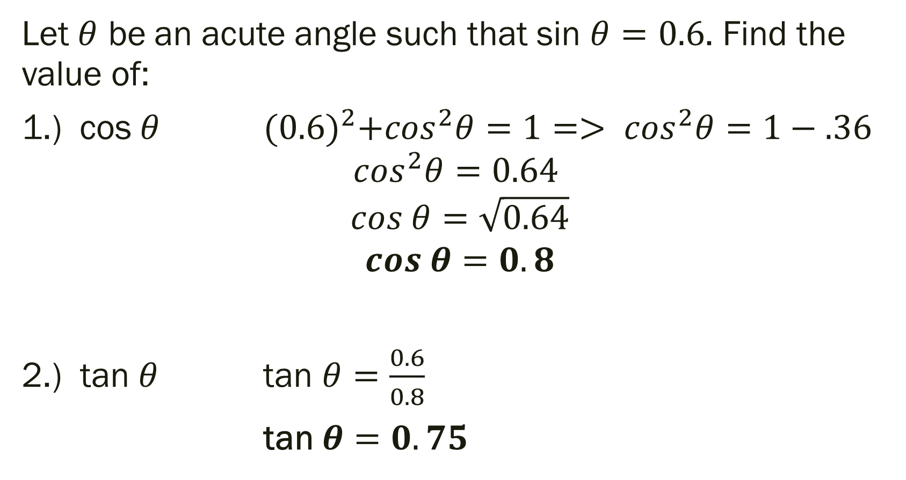
Solution:
Let $θ$ be an acute angle such that sin $θ=0.6$. Find the value of:
1.) cos$θ$ ${(0.6)}^{2}+cos^{2}θ=1=> cos^{2}θ=1−.36$
$$cos^{2}θ=0.64$$
$$cos θ=\sqrt{0.64}$$
$$cos θ=0.8$$
2.) tan $θ$ tan $θ=\frac{0.6}{0.8}$
tan $θ=0.75$

Slide 14
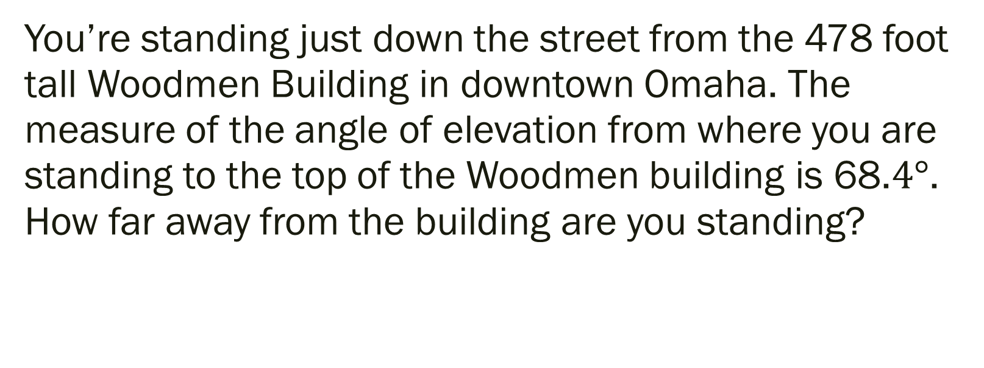
Example: Applications to Real Life
You’re standing just down the street from the 478 foot tall Woodmen Building in downtown Omaha. The measure of the angle of elevation from where you are standing to the top of the Woodmen building is 68.$4°$. How far away from the building are you standing?

Slide 15
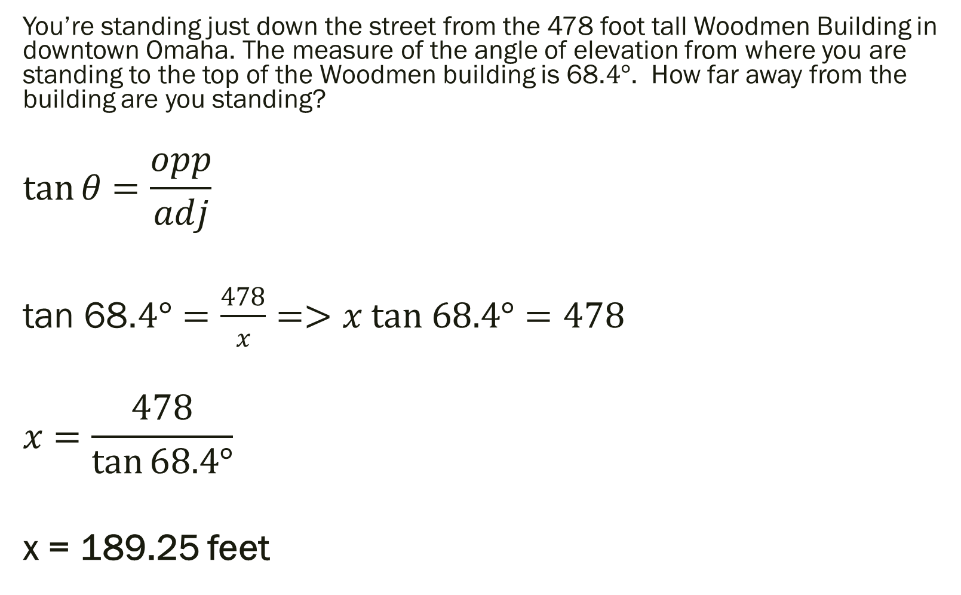
Solution:
You’re standing just down the street from the 478 foot tall Woodmen Building in downtown Omaha. The measure of the angle of elevation from where you are standing to the top of the Woodmen building is 68.$4°$. How far away from the building are you standing?
$$\tan{θ=\frac{opp}{adj}}$$
tan 68.$4°=\frac{478}{x}=>x tan 68.4°=478$
$$x=\frac{478}{\tan{68.4°}}$$
x = 189.25 feet

Slide 16

Example: Second Application
A historic lighthouse is 200 yards directly south from a bike path along a lake. A walk way to the lighthouse is 400 yards long. Find the acute angle $θ$ between the bike path and the walkway.

Slide 17
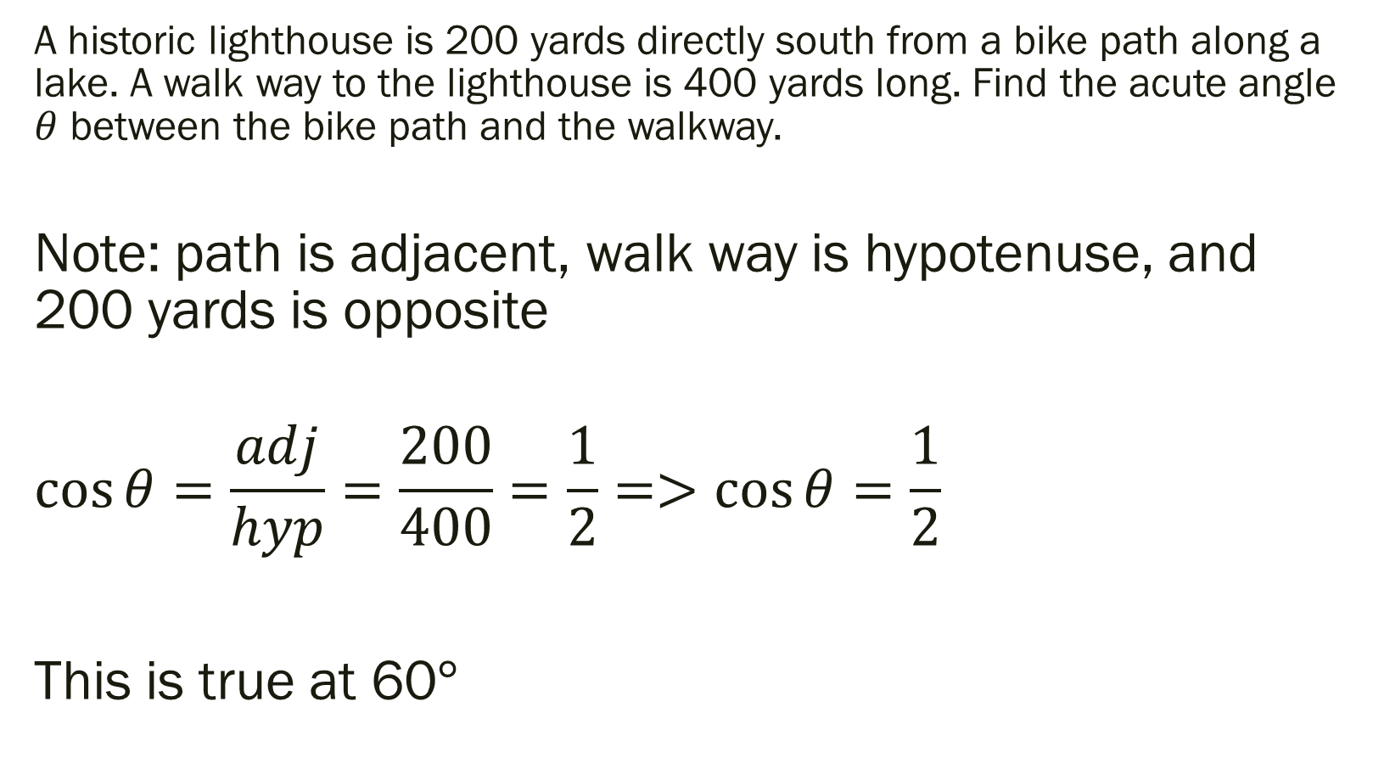
Example: Second Application
A historic lighthouse is 200 yards directly south from a bike path along a lake. A walk way to the lighthouse is 400 yards long. Find the acute angle $θ$ between the bike path and the walkway.
Note: path is adjacent, walk way is hypotenuse, and 200 yards is opposite
$$\cos{θ=\frac{adj}{hyp}=\frac{200}{400}=\frac{1}{2}=>\cos{θ=\frac{1}{2}}}$$
This is true at 60$°$

Slide 18
4.4 Trig Functions of Any Angle
Objective: Evaluate trig functions of any angles

Slide 19
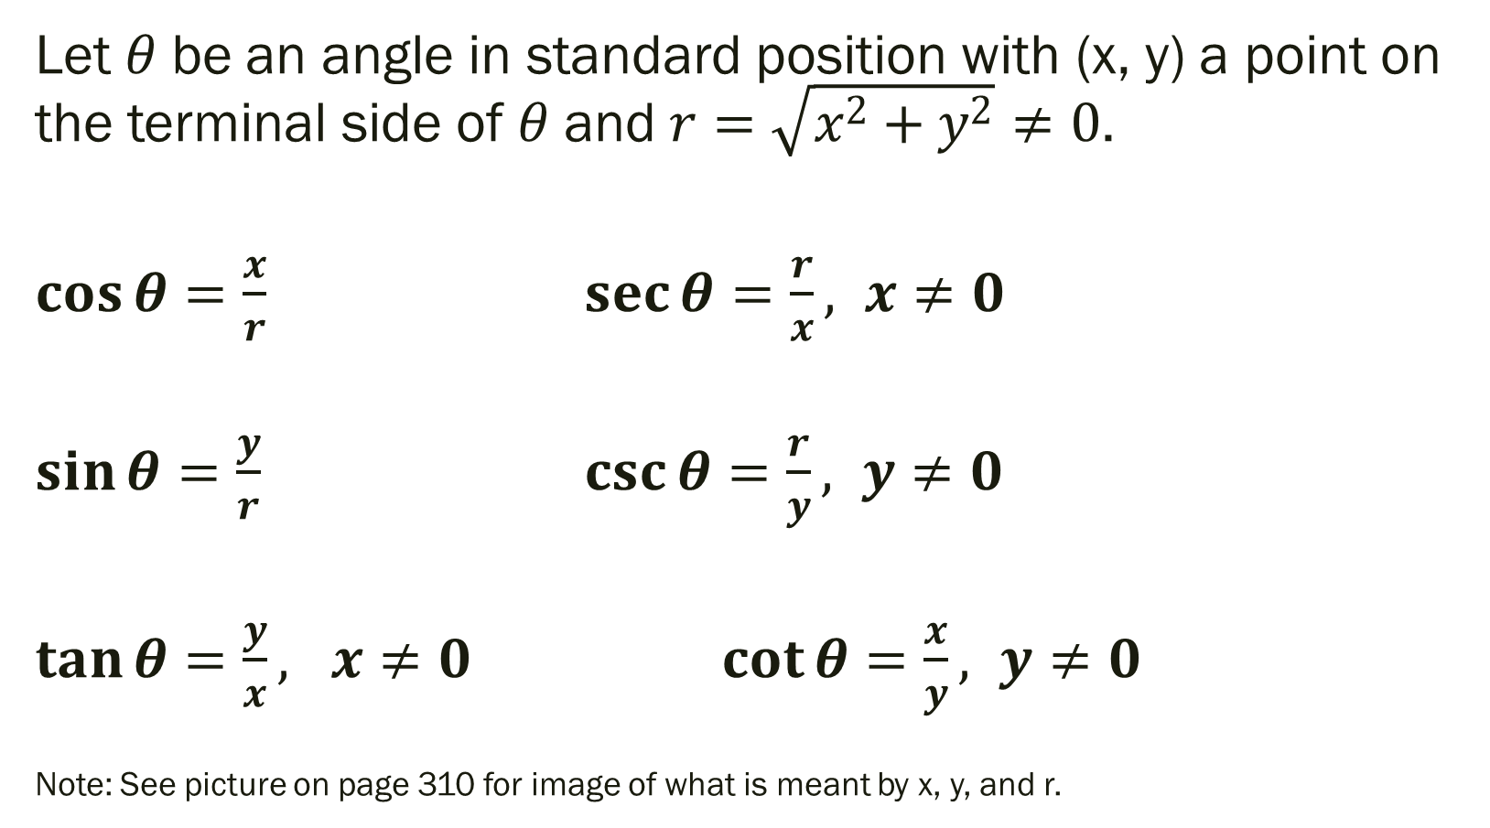
Definitions of Trigonometric Functions of Any Angle
Let $θ$ be an angle in standard position with (x, y) a point on the terminal side of $θ$ and $r=\sqrt{x^{2}+y^{2}}≠0$.
$\cos{θ=\frac{x}{r}}$ $\sec{θ=\frac{r}{x}, x≠0}$
$\sin{θ=\frac{y}{r}}$ $\csc{θ=\frac{r}{y}, y≠0}$
$\tan{θ=\frac{y}{x}, x≠0}$ $\cot{θ=\frac{x}{y}}, y≠0$
Note: See picture on page 310 for image of what is meant by x, y, and r.

Slide 20
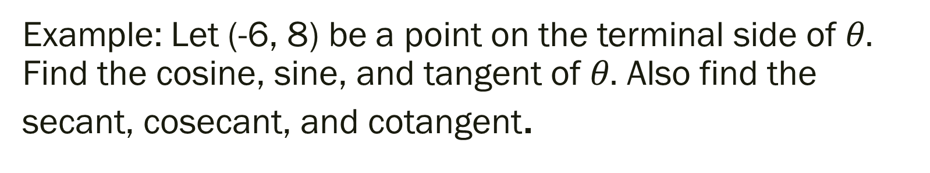
Example: Let (-6, 8) be a point on the terminal side of $θ.$ Find the cosine, sine, and tangent of $θ.$ Also find the secant, cosecant, and cotangent.

Slide 21
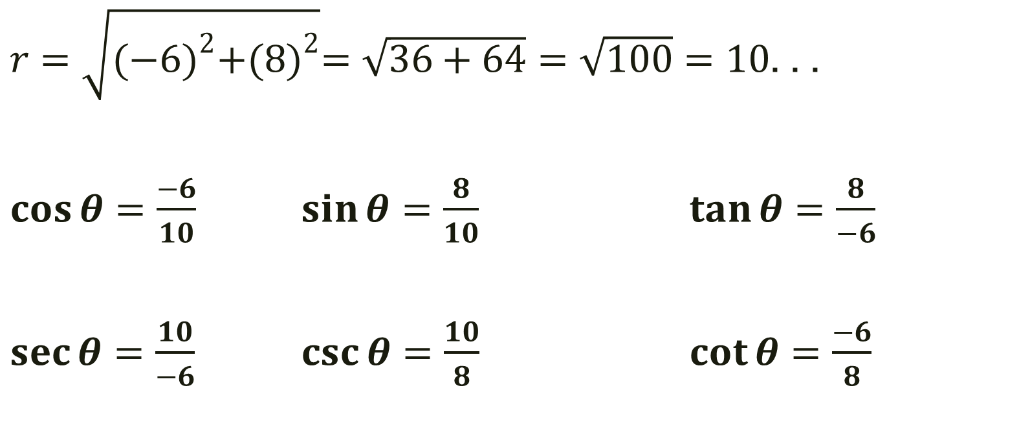
Example: Let (-6, 8) be a point on the terminal side of $θ.$ Find the cosine, sine, and tangent of $θ.$ Also find the secant, cosecant, and cotangent.
$r=\sqrt{{(−6)}^{2}+{(8)}^{2}}=\sqrt{36+64}=\sqrt{100}=10$. . .
$\cos{θ=\frac{−6}{10}}$ $\sin{θ=\frac{8}{10}}$ $\tan{θ=\frac{8}{−6}}$
$\sec{θ=\frac{10}{−6}}$ $\csc{θ=\frac{10}{8}}$ $\cot{θ=\frac{−6}{8}}$

Slide 22

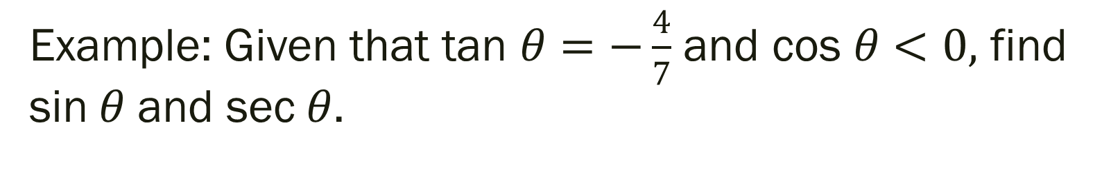
Example: Given that tan $θ=−\frac{4}{7}$ and cos $θ<0,$ find sin$θ$ and sec$θ$.
-- Note that $θ$ is in Quadrant II because that is the only quadrant in which tangent is negative and cos is negative.

Slide 23
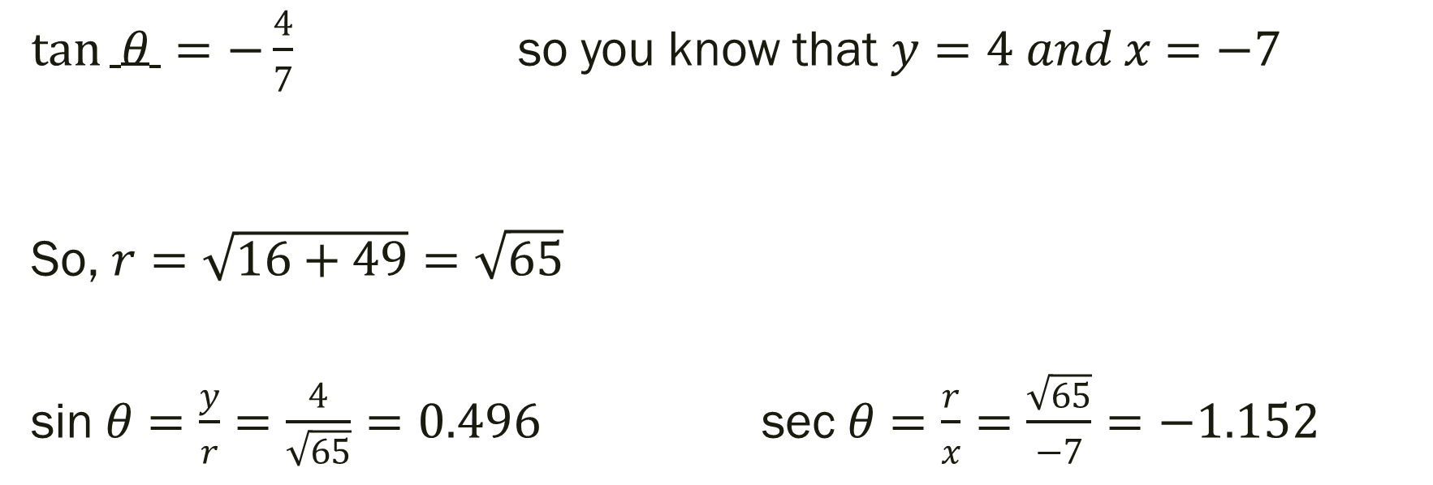
Example: Given that tan $θ=−\frac{4}{7}$ and cos $θ<0,$ find sin$θ$ and sec$θ$.
$\tan{ θ =−\frac{4}{7}}$ so you know that $y=4 and x=−7$
So, $r=\sqrt{16+49}=\sqrt{65}$
sin$θ=\frac{y}{r}=\frac{4}{\sqrt{65}}=0.496$ sec$θ=\frac{r}{x}=\frac{\sqrt{65}}{−7}=−1.152$

Slide 24
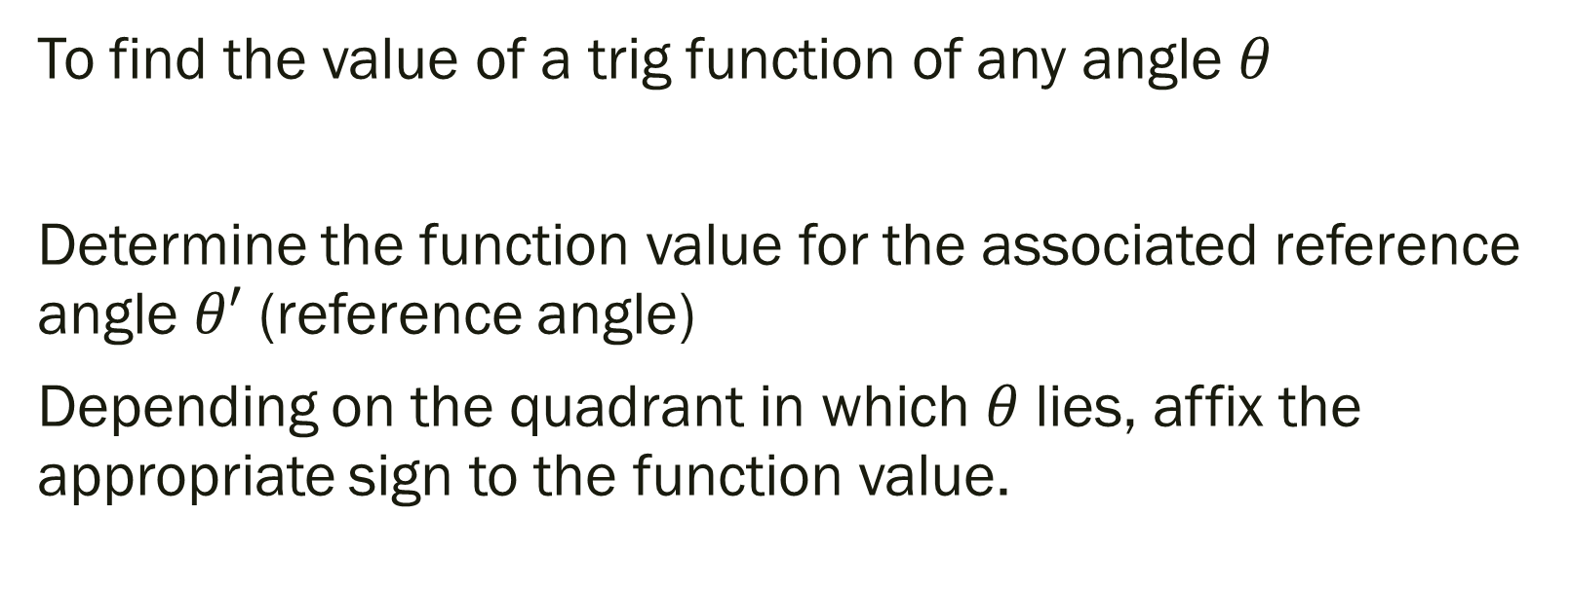
Evaluating Trig Functions of Any Angle
To find the value of a trig function of any angle $θ$
Determine the function value for the associated reference angle $θ′$ (reference angle)
Depending on the quadrant in which $θ$ lies, affix the appropriate sign to the function value.

Slide 25
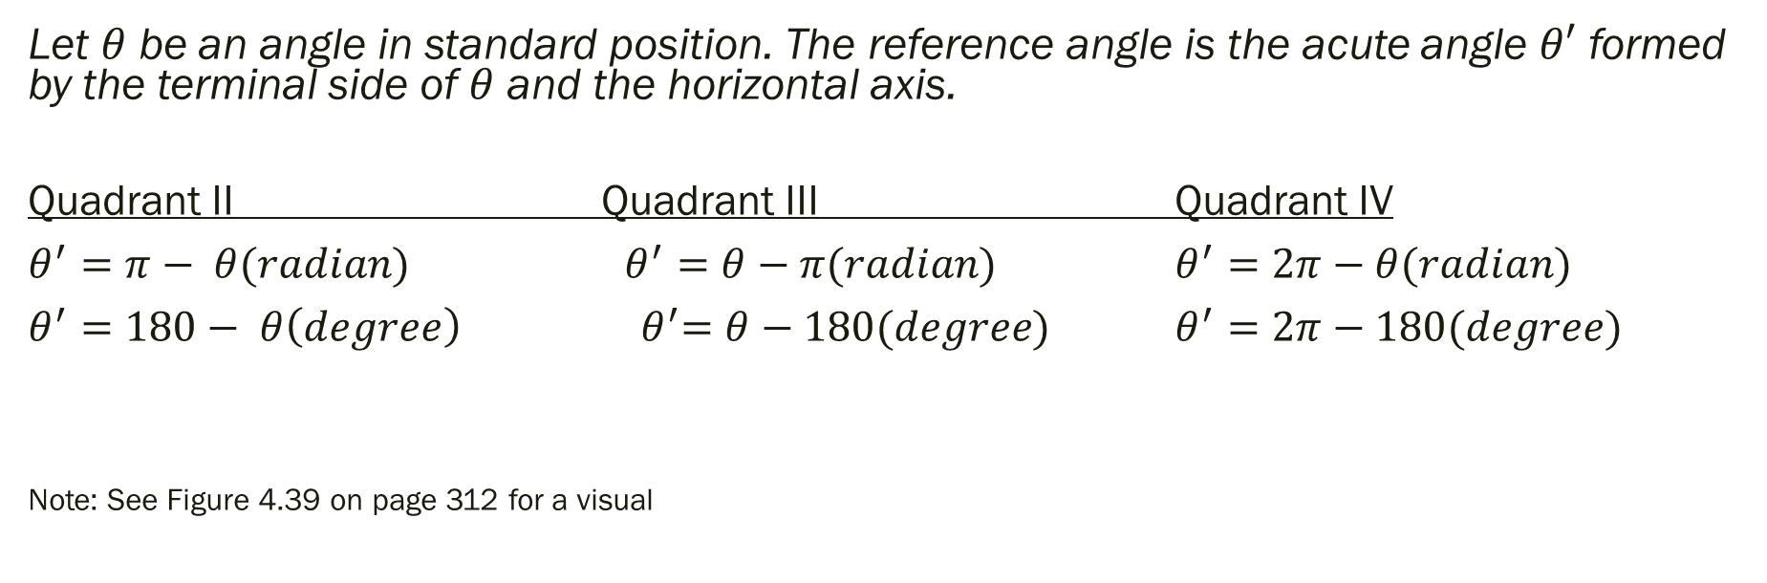
Reference Angles
Let $θ$ be an angle in standard position. The reference angle is the acute angle $θ′$ formed by the terminal side of $θ$ and the horizontal axis.
Quadrant II Quadrant III Quadrant IV
$θ^{′}=π− θ(radian)$ $θ^{′}=θ−π(radian)$ $θ^{′}=2π−θ(radian)$
$θ^{′}=180− θ\left(degree\right)$ ${ θ}^{′}=θ−180(degree)$ $θ^{′}=2π−180(degree)$
Note: See Figure 4.39 on page 312 for a visual

Slide 26

Example
Find the reference angle $θ′$
$1.) θ=290°$
$2.) θ=3.4$

Slide 27
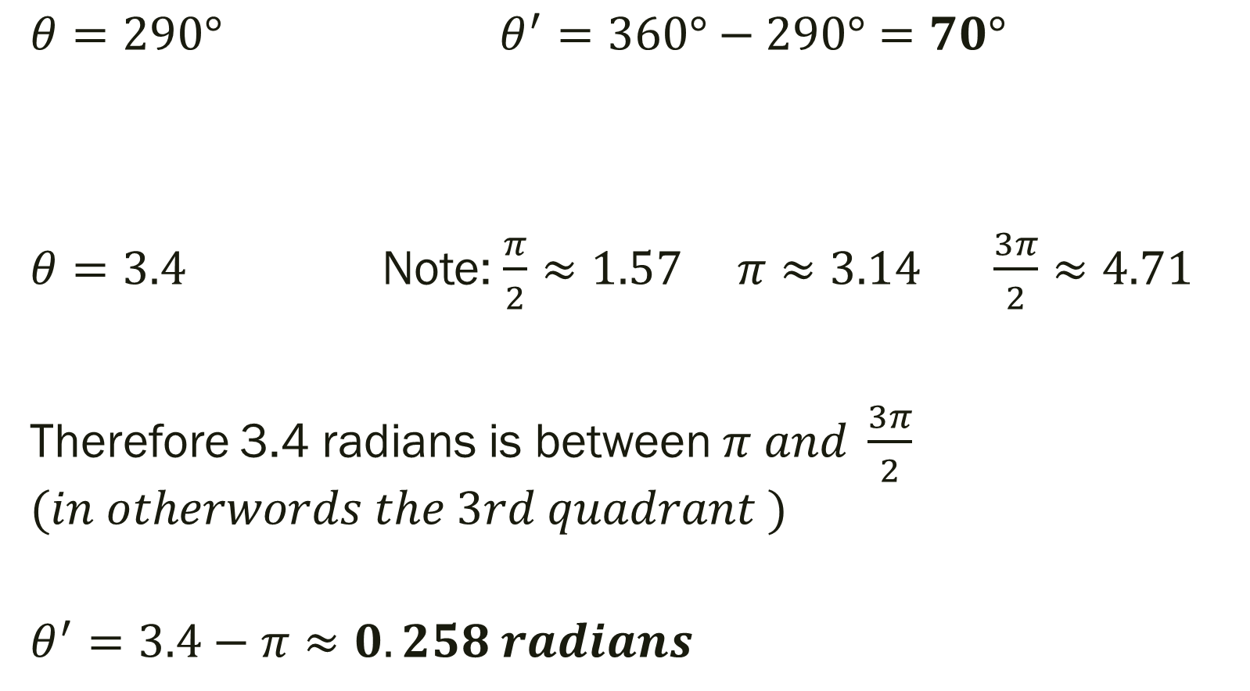
Example
$θ=290°$ $θ^{′}=360°−290°=70°$
$θ=3.4$ Note: $\frac{π}{2}≈1.57 π≈3.14 \frac{3π}{2}≈4.71$
Therefore 3.4 radians is between $π and \frac{3π}{2}$ $$(in otherwords the 3rd quadrant )$$
$$θ^{′}=3.4−π≈0.258 radians$$

Slide 28
For Next Time
Page 306 #1, 5-6, 30-31, 37-40, 45, 47, 57, 63-64, 67, 71
Get a Head Start…
Page 316 #9, 11, 13, 19-24, 37-44, 45-51 (odd), 69, 71, 97

